Slide 1


Building a Simple Calculator in Java
Explore the step-by-step process of developing a user-friendly Java-based calculator application, from designing the interface to implementing the core functionality.
Name : Malak Mohsen Mosa
ID : 2301247

Slide 2
Introduction
This presentation will guide you through the development of a simple calculator application using Java. We'll explore the step-by-step process, from designing the user interface to implementing the core functionality that empowers users to perform basic arithmetic operations with ease.

Slide 3

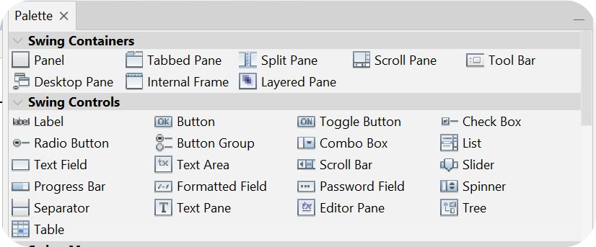
User Interface
User InterfaceDescription of the GUI components:
text field
number buttons
operator buttons, etc…

Slide 4
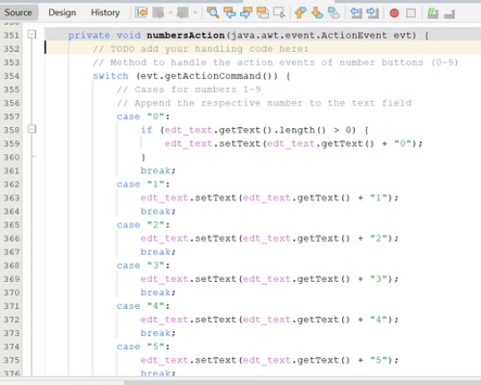
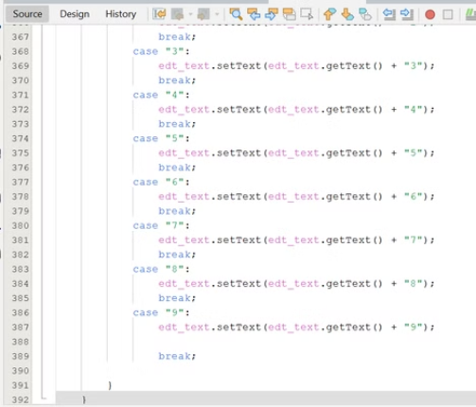
Event Handling_Numbers
Handling action events for number buttons (0-9) Appending numbers to the text field
Numbers Explanation of the numbersAction method

Slide 5

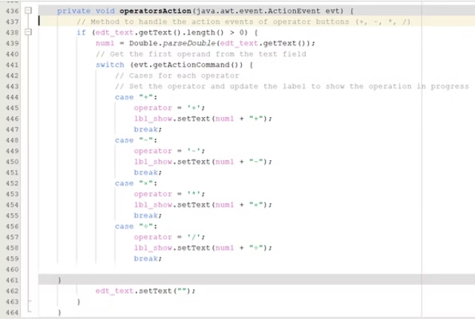
Event Handling_Operators

Slide 6

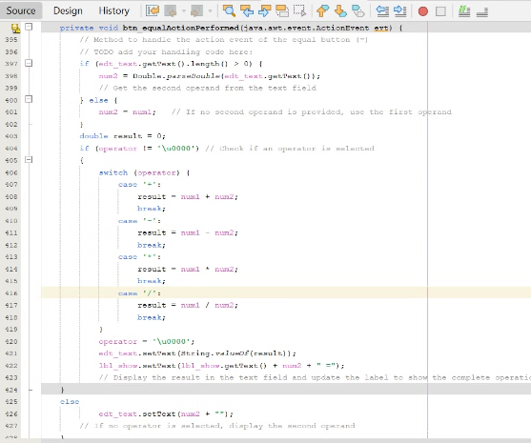
btn_equalActionPerformed :
Method to handle the action event of the equal button (=)

Slide 7
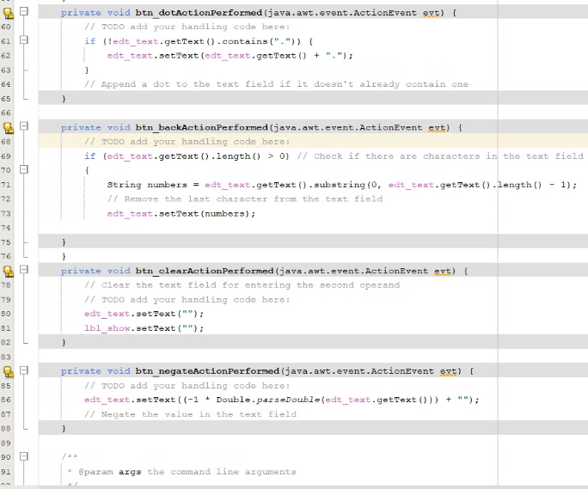
Other Methods
btn_dotActionPerformed
btn_backActionPerformed
btn_clearActionPerformed
btn_negateActionPerformed

Slide 8


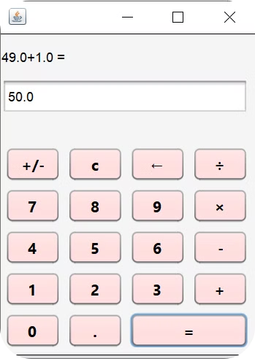


Performing calculations
Input Numbers
Users can enter the numbers they want to calculate using the numeric keypad buttons on the interface.
Select Operator
Once the numbers are entered, the user selects the desired arithmetic operation by pressing the corresponding button (+, -, ×, ÷).
Calculate Result
The calculator's logic processes the numbers and operator, performing the requested calculation and displaying the final result on the screen.

Slide 9



Conclusion
1
Summary of key points covered in the presentation
2
Importance of understanding the code structure and event handling in GUI applications
3
Encouragement for further exploration and learning
In conclusion, this presentation has guided you through the development of a user-friendly Java-based calculator application. By focusing on the core components - the intuitive interface, reliable event handling, and accurate calculation logic - we've laid the foundation for a powerful and versatile calculator tool. As you move forward, consider incorporating advanced features to enhance the user experience and expand the calculator's capabilities even further.

Slide 10



Q&A
Now that we've covered the key aspects of building a simple calculator in Java, let's open the floor to your questions. This is an opportunity to delve deeper into specific areas of interest or clarify any doubts you may have about the development process.
Ask Questions
Engage in Discussion
Provide Feedback
Feel free to raise your hand or use the chat function to submit your queries. We're here to provide thorough answers and ensure you have a comprehensive understanding of the calculator project.
This is a collaborative environment, so we encourage you to actively participate in the discussion. Share your insights, ideas, or any practical experiences you may have with similar projects.
Your feedback is invaluable in helping us improve the presentation and ensure it meets your needs. Let us know what you found most useful or if there are any areas we can further clarify or expand on.

